Slide 1
Status and History of the IMO Video Meteor Network
Meteoroids 2013 Conference, Poznan/Poland, August 26-30, 2013
Sirko Molau, Geert Barenten, IMO

Slide 2
Agenda
What is the IMO Network?
History & Current Status
Major Achievements
Conclusions & Acknowledgements

Slide 3
What is the IMO Network?
International network of amateur astronomers who obtain video meteor observations on a regular basis.
Participants from many, mainly European countries.
Observers operate 1..5 video cameras at single/multiple locations.
Nearly all stations are automated and operate every night.
Designed as single-station network to allow observers from anywhere in the world to join.
All stations use identical digitizer hardware and the MetRec software for meteor detection and analysis.
Observations are reported to the IMO network database, which is centrally maintained and quality-controlled.

Slide 4
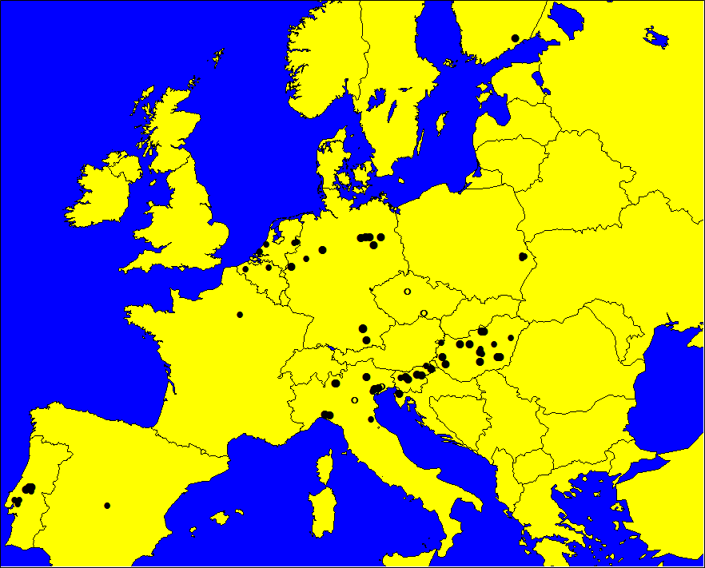
History & Current Status
First camera started automated meteor observation in 03/1999
Network history can be divided in three main phases.
Year | Cameras | Observers | Countries
1999 | 8 | 7 | 3
2000 | 11 | 8 | 5
2001 | 19 | 12 | 7
2002 | 19 | 12 | 8
2003 | 23 | 15 | 8
2004 | 21 | 11 | 7
2005 | 23 | 17 | 9
2006 | 28 | 19 | 9
2007 | 30 | 22 | 9
2008 | 37 | 24 | 10
2009 | 43 | 24 | 10
2010 | 57 | 32 | 12
2011 | 80 | 46 | 16
2012 | 81 | 46 | 15
IMO Network Cameras in Central Europe 2012
Phase | Start Year | Characteristics
1 | 1999 | Network setup, software development, initial data collection
2 | 2006 | Comprehensive meteor shower analyses from single station data
3 | 2010 | Calculation of flux densities, online flux viewer tool

Slide 5
Phase 1: Data Collection
Highlights
Network outcome and data quality has been increasing continuously.
Not a single night missed since June 2007.

Slide 6
Phase 2: Meteor Shower Analyses
Automated meteor shower detection
IMC 2006 | 188,068 meteors (01/1993-07/2006) | Base procedure based on Bayes' decision rule Two-step detection (radiant and shower search) Iterative radiant search
IMC 2008 | 359,957 meteors (01/1993-07/2008) | Observability function and activity profiles Improved detection algorithm (new alitude formula, Laplace distribution)
WGN 37:4 2009 | 451,282 meteors (01/1993-04/2009) | Based on MDC meteor shower list Manual refinement of search results
WGN 38:5 2010 | 168,830 meteors only SL 250-315° (01/1993-12/2009) | Specific analysis of PER/AUR region in September/October
IMC 2013 | 1,063,057 meteors (01/1993-12/2011) | Bi-directional match between IMO database and MDC meteor shower list

Slide 7
Phase 2: Meteor Shower Analyses
Automated meteor shower detection (single station analysis)
Cut the data into sol long slices of 2° length, 1° shift.
Compute for each meteor M in each sol long slice and all possible radiants R (α / δ / v_{inf}) the conditional probability P (M | R).
Determine the radiants iteratively:
Start: Accumulate P (M | R) over all possible R
Loop: Select the radiant R` with largest probability P (M | R`)
Determine all meteors M` belonging to R`
Accumulate P (M‘ | R) over all possible R and subtract it from the original distribution
End: Reassign the meteors to the radiants and recompute the shower parameters
Connect similar radiants in consecutive sol long intervals.
Compute radiant position / drift, shower velocity / activity profile.
Match the showers with the MDC list.

Slide 8
Phase 2: Meteor Shower Analyses
Highlights
Automated searches for meteor showers in the optical domain covering all solar longitudes.
Discovery of more than 20 unknown meteor showers.
Confirmation of >100 showers from the MDC working list.
Detection of a variability in meteor shower velocity over time.
Data import to EDMOND DB.

Slide 9
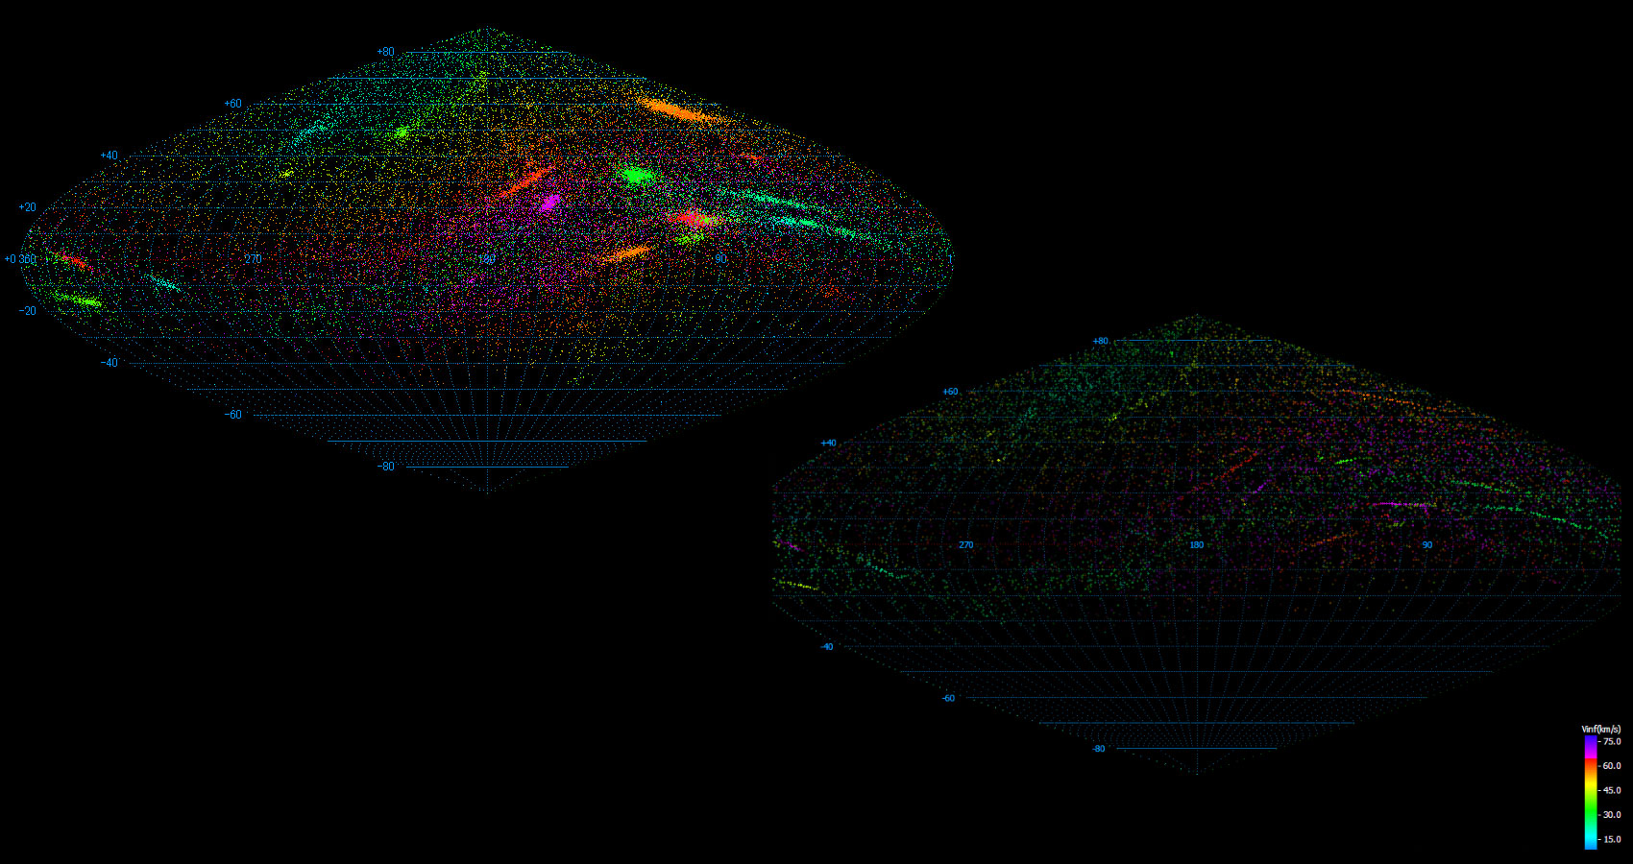
Phase 2: Meteor Shower Analyses
IMO Network 2009
Each dot one radiant
17,000 radiants with 10-10³ met.
Radiant velocity color coded
Radiants strength intensity coded
SonotaCo Network 2009
Each dot one orbit
39,000 orbits
Radiant velocity color coded

Slide 10
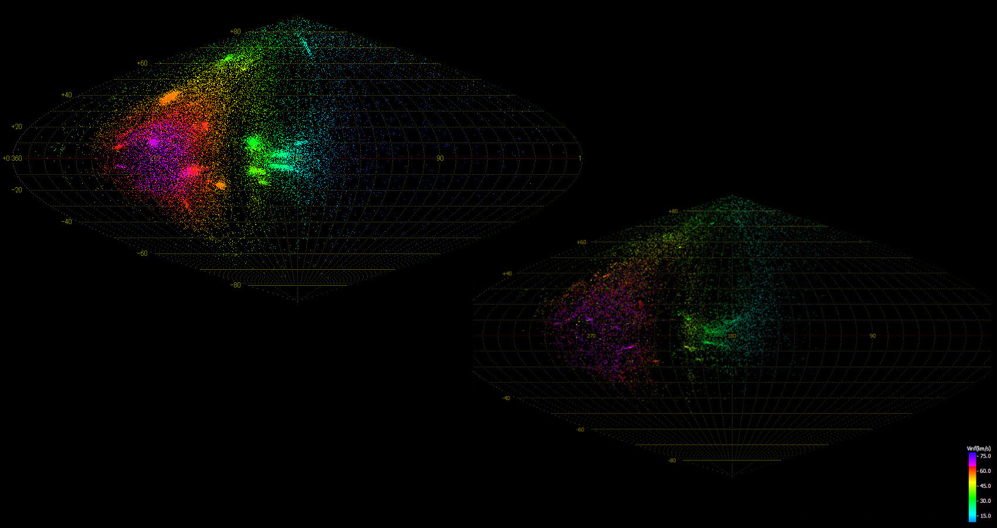
Phase 2: Meteor Shower Analyses
IMO Network 2009
Same dataset
Antihelion centered graph.
SonotaCo Network 2009
Same dataset
Antihelion centered graph.

Slide 11
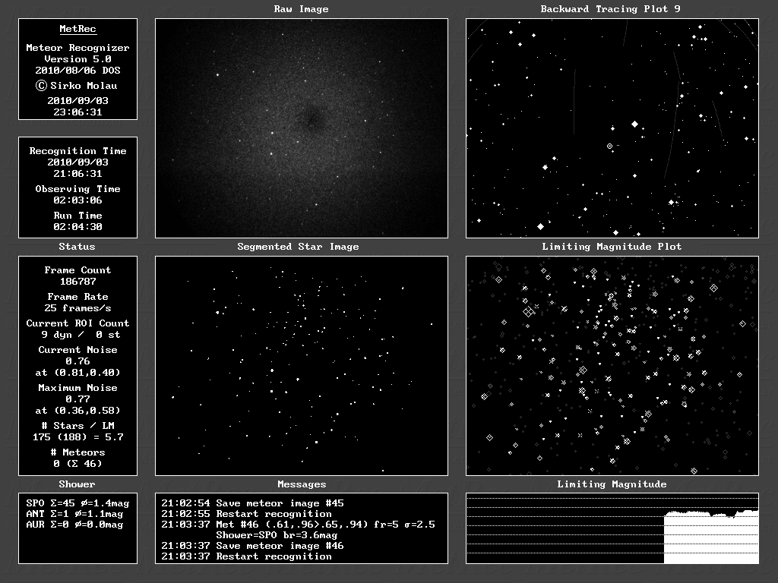
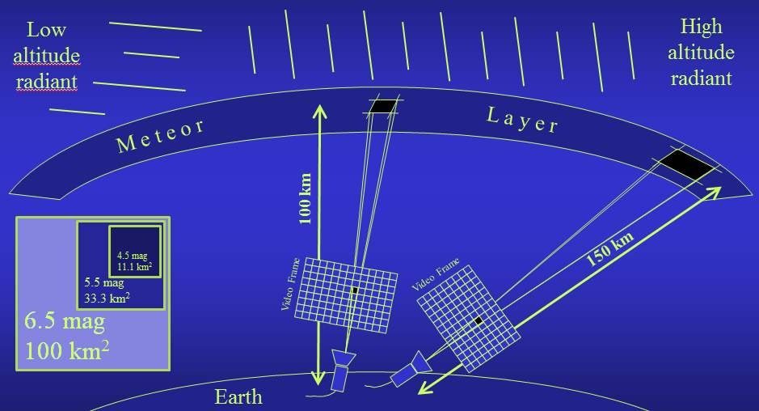
Phase 3: Flux Density Determination
Basis: Automated calculation of the limiting magnitude
Flux density calculation is based on size of fov, eff. observing time, meteor count, stellar lm, lm loss by meteor motion, radiant altitude, meteor layer altitude, population index

Slide 12
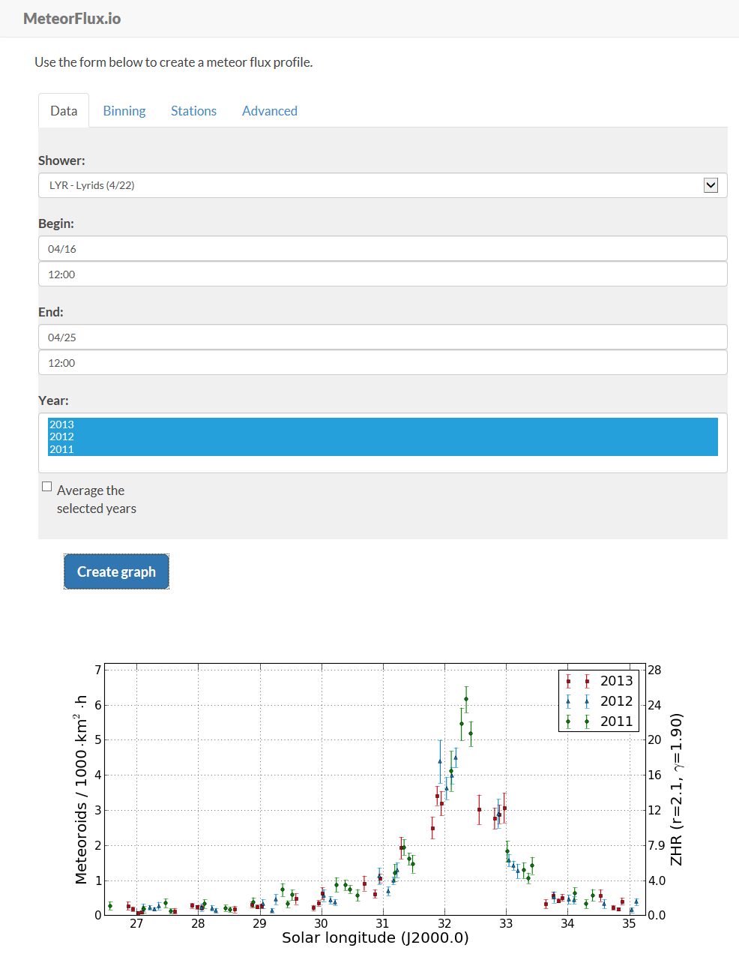
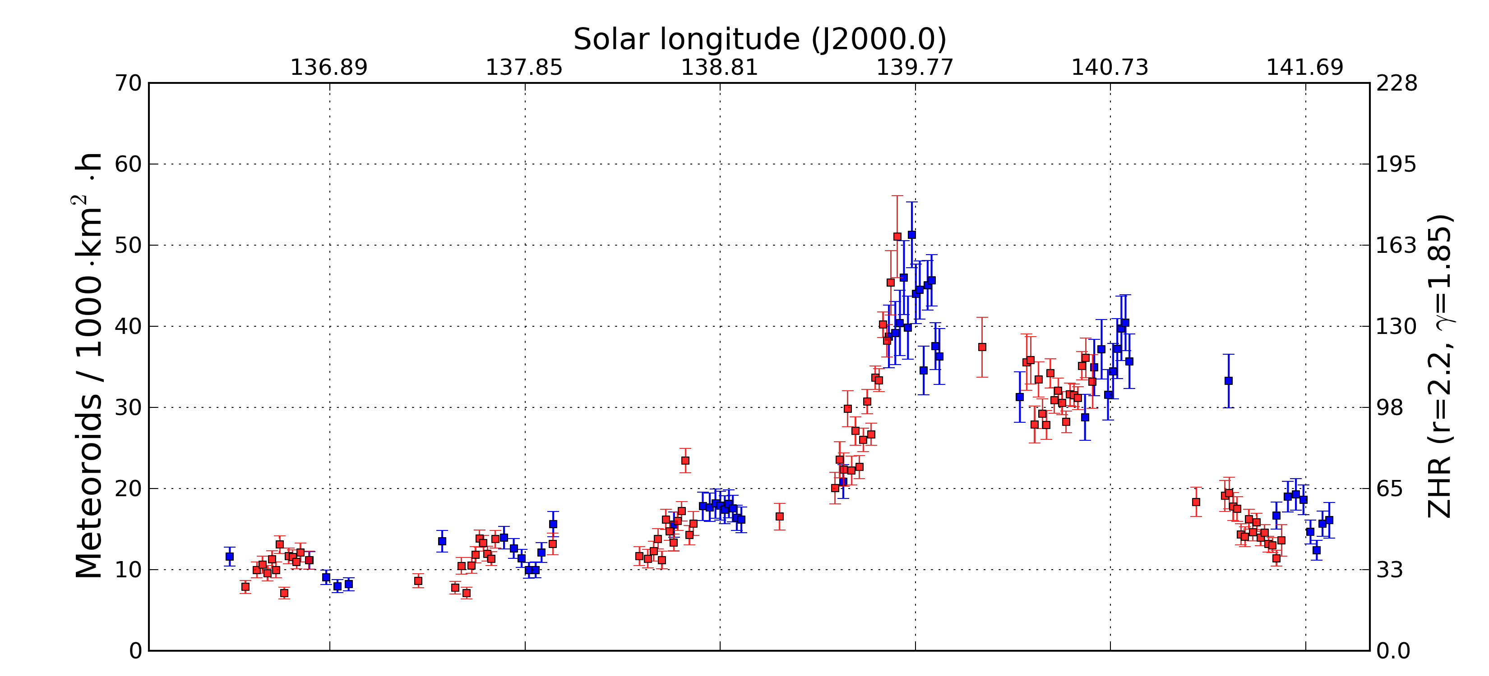
Phase 3: Flux Density Determination
Observers upload flux data.
MetRec Flux Viewer* allows to analyse and visualize flux data online.
Flux density profiles for every shower since 2011.
* See poster by G. Barentsen, S. Molau
Perseid flux density profile 2011 (blue) and 2012 (red)

Slide 13
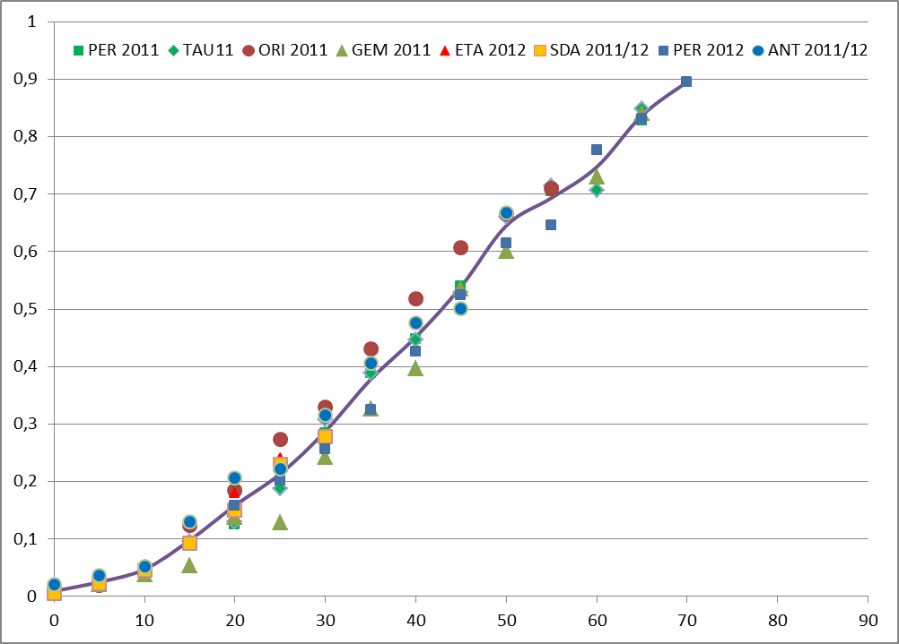
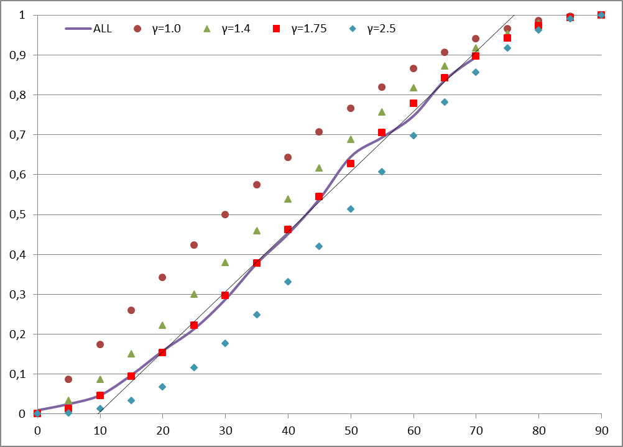
Phase 3: Flux Density Determination
Highlights
Determination of a zenith exponent γ between 1.5 and 2.0 for different major meteor showers.
Average value of γ=1.75.
Per 2011 (blue) / 2012 (red)
Uncorrected flux density vs. radiant altitude
Radiant altitude correction with γ=1.75

Slide 14
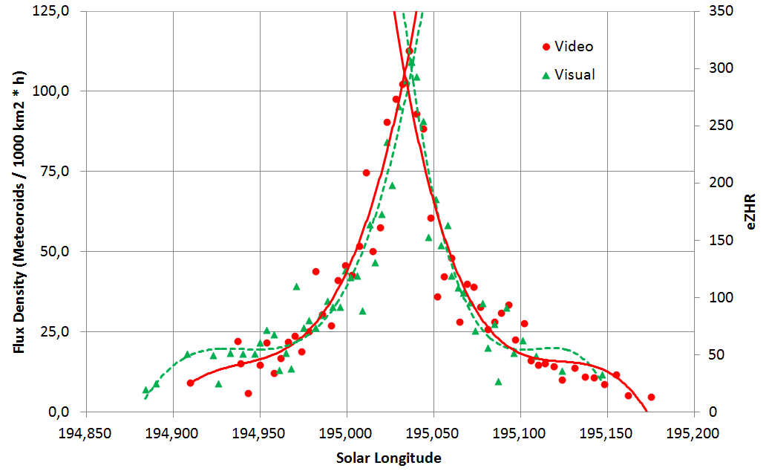
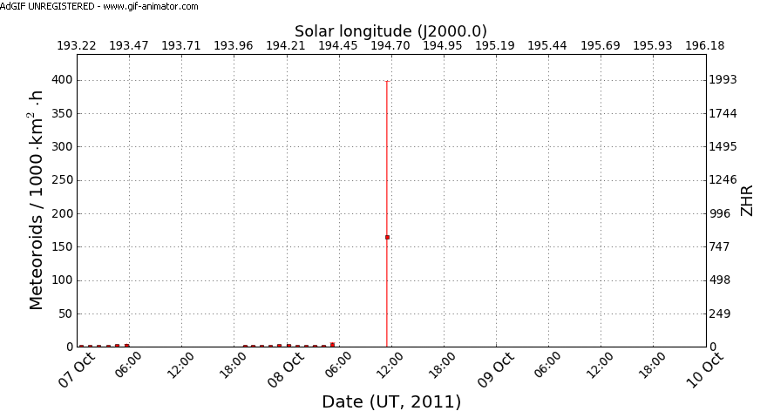
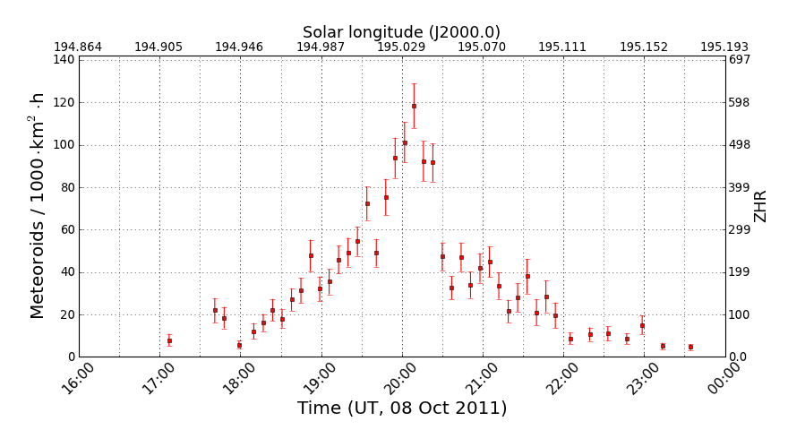
Phase 3: Flux Density Determination
Highlights
Automated online real-time flux density display from Draconid outburst 2011.
Precise determination of peak time, flux density and FHWM.
Comparison between visual and video data
Real-time flux density profile.
High resolution flux density profile.

Slide 15
Conclusions & Acknowledgements
The IMO Video Meteor Network is a successful international collaboration of amateur video meteor observers.
After the first data collection phase, plenty of analyses have been carried out touching different aspects of meteor research.
Further analysis results and discoveries may be expected thanks to a rapidly growing database, improving data quality and refined analysis techniques.
Great thanks to all video meteor observers
contributing to the IMO network and
providing the data for all of these analyses.

Slide 16
Thanks for your Attention
Questions?

