Slide 1
Meteor Showers Identified from a Million Video Meteors
International Meteor Conference, Poznan/Poland, August 22-25, 2013
Sirko Molau, AKM, Germany

Slide 2
Agenda
History
Procedure
Tools
Statistics
Results
Conclusions

Slide 3
History
Searching the IMO database for meteor showers is not new ...
IMC 2006 | 188,068 meteors (01/1993-07/2006) | Base procedure based on Bayes' decision rule two-step detection (radiant and shower search) iterative radiant search Gaussian distribution
IMC 2008 | 359,957 meteors (01/1993-07/2008) | Improvements observability function and activity profiles corrected meteor counts improved meteor altitude formula / velocity estimates Laplace distribution
WGN 37:4 2009 | 451,282 meteors (01/1993-04/2009) | Improvements: Based on MDC meteor shower list manual refinement of results
WGN 38:5 2010 | 168,830 meteors only SL 250-315° (01/1993-12/2009) | Specific analysis of PER/AUR region in September/October
IMC 2013 | 1,063,057 meteors (01/1993-12/2011) | Improvements: see next slides

Slide 4
Base Procedure
Cut the data into sol long slices of 2° length, 1° shift.
Compute for each meteor M in each slice and all possible radiants R (α / δ / v_{inf}) the conditional probability P (M | R).
Determine the radiants iteratively:
Start: Accumulate P (M | R) over all possible R
Loop: Select the radiant R` with largest probability P (M | R`)
Determine all meteors M` belonging to R`
Accumulate P (M‘ | R) over all possible R and subtract it from the original distribution
End: Reassign the meteors to the radiants and recompute the shower parameters
Connect radiants with similar position/velocity in consecutive solar longitude intervals.
Compute shower parameters: Radiant position, drift, velocity.
Compare the showers against the MDC list.

Slide 5
Enhancements 2012/13
More than a million single station meteors available.
Introduction of radiant rank, i.e. at which position a radiant is located in the sorted radiant list of that sol long interval.
Forward/backward radiant search during shower detection.
Early publishing of unprocessed radiant and meteor shower list in the web.
Intermediate results presented in monthly video network reports.
In preparation of IMC 2013, bi-directional match between IMO video network meteor shower list and latest MDC list including all showers.

Slide 6
Analysis Steps
Phase 1: Automatic detection of showers in the video meteor database (minimum duration: 5° sol long), identification according to MDC list, manual refinement/rejection of showers → 101 showers.
Phase 2: Detailed manual check for missing „established“ MDC showers → 6 additional showers.
Phase 3: Manual check for all MDC „workling list“ showers, completion of list with short duration and weak showers, disambiguation → 22 additional showers.
Phase 4: Identification showers that belong to the Antihelion source.

Slide 7
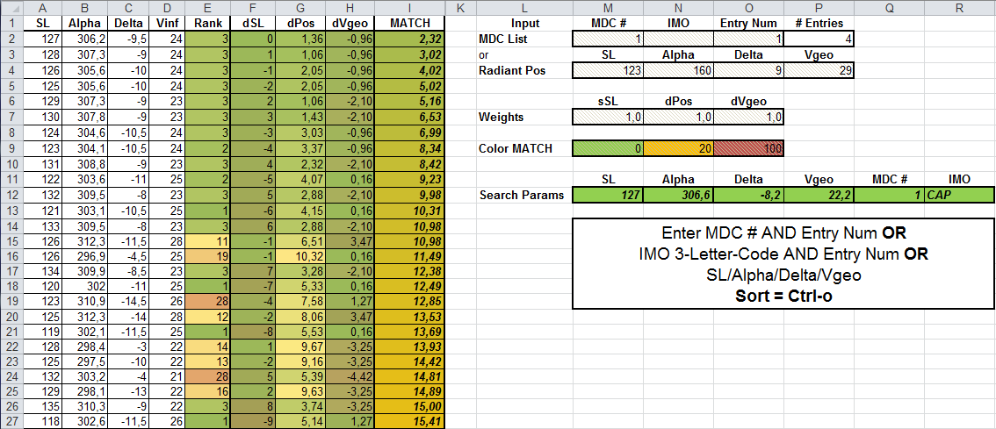
Tools
To match the IMO video network list with the MDC list, a little „Excel tool“ (available to everyone) was created.
Functions:
Find the best matching MDC list shower given a radiant found in the IMO video network radiant list.
Find the best matching radiant in the IMO video network radiant list given a MDC meteor shower.
Find the best matching MDC list shower and IMO video network radiant given arbitrary sl/α/δ/v_{geo} values.

Slide 8
Statistics (I)
Observers contributing >1,000 meteors.
Name | IMO Code | Nights | Teff | Meteors |  | Name | IMO Code | Nights | Teff | Meteors
Sirko Molau | MOLSI | 3,138 | 31,410.0 | 185,158 |  | Istvan Tepliczky | TEPIS | 414 | 2,342.4 | 11,964
Enrico Stomeo | STOEN | 1,121 | 15,001.5 | 93,548 |  | Stephen Evans | EVAST | 457 | 2,807.3 | 11,411
Javor Kac | KACJA | 1,794 | 18,791.5 | 73,296 |  | Eckehard Rothenberg | ROTEC | 637 | 2,841.8 | 10,476
Jörg Strunk | STRJO | 2,247 | 17,642.7 | 63,337 |  | Steve Quirk | QUIST | 341 | 3,041.8 | 10,109
Stefano Crivello | CRIST | 984 | 9,848.1 | 53,594 |  | Mike Otte | OTTMI | 424 | 1,987.8 | 8,451
Rui Goncalves | GONRU | 971 | 11,257.2 | 48,301 |  | Hans Schremmer | SCHHA | 576 | 2,018.5 | 7,415
Flavio Castellani | CASFL | 1,476 | 11,953.8 | 38,735 |  | Carlos Saraiva | SARAN | 168 | 2,031.8 | 6,584
Robert Lunsford | LUNRO | 803 | 5,102.1 | 33,229 |  | Paolo Ochner | OCHPA | 408 | 2,058.4 | 6,239
Antal Igaz | IGAAN | 684 | 6,748.3 | 28,765 |  | other | OTHER | 14 | 91.4 | 6,037
Ilkka Yrjölä | YRJIL | 1,299 | 7,050.5 | 26,356 |  | Mirko Nitschke | NITMI | 213 | 942.5 | 5,425
Steve Kerr | KERST | 426 | 3,161.6 | 25,183 |  | Biondani Roberto | ROBBI | 294 | 1,583.4 | 5,320
Detlef Koschny | KOSDE | 924 | 5,441.0 | 23,952 |  | Rob McNaught | MCNRO | 52 | 401.2 | 5,285
Bernd Brinkmann | BRIBE | 1,235 | 6,144.8 | 23,627 |  | József Morvai | MORJO | 357 | 1,704.4 | 5,156
Wolfgang Hinz | HINWO | 779 | 4,447.8 | 22,605 |  | Maciej Maciejewski | MACMA | 132 | 2,022.7 | 4,890
Rosta Štork | STORO | 139 | 1,356.4 | 21,368 |  | Ulrich Sperberg | SPEUL | 159 | 1,021.6 | 4,339
Klaas Jobse | JOBKL | 251 | 1,801.9 | 20,090 |  | Karoly Jonas | JONKA | 235 | 1,127.1 | 4,210
Maurizio Eltri | ELTMA | 646 | 4,322.2 | 19,987 |  | Leo Scarpa | SCALE | 118 | 916.9 | 3,896
Carl Hergenrother | HERCA | 1,102 | 7,432.3 | 19,440 |  | Szilárd Csizmadia | CSISZ | 271 | 1,005.5 | 3,591
Jürgen Rendtel | RENJU | 647 | 3,823.4 | 17,223 |  | Martin Breukers | BREMA | 86 | 720.4 | 2,696
Erno Berkó | BERER | 321 | 4,195.6 | 16,574 |  | Malcolm Currie | CURMA | 123 | 533.9 | 2,133
Stane Slavec | SLAST | 1,278 | 5,948.8 | 16,448 |  | Grigoris Maravelias | MARGR | 36 | 225.0 | 1,783
Mihaela Triglav | TRIMI | 944 | 4,246.4 | 14,735 |  | Stefan Ueberschaer | UEBST | 173 | 882.3 | 1,684
Orlando Benitez-Sanchez | BENOR | 1,018 | 5,227.4 | 13,899 |  | Zoltán Zelko | ZELZO | 74 | 585.2 | 1,578
Mitja Govedic | GOVMI | 618 | 3,121.5 | 13,718 |  | Gregor Kladnik | KLAGR | 59 | 316.4 | 1,469
Zsolt Perkó | PERSZ | 378 | 2,042.0 | 13,243 |  | Milos Weber | WEBMI | 29 | 49.4 | 1,050

Slide 9
Statistics (II)
Each meteor contributes to two consecutive intervals.
Between 1,458 meteors (sol long 55°) and 35,000 (sol long 262°) meteors per interval.

Slide 10
Statistics (III)
365,000 (35%) of all meteors were assigned to showers.
106 meteor showers detected (without Antihelion), corresponding to 39 „established“ and 77 „working list“ MDC showers.
23 segments of the Antihelion source detected, corresponding to 2 „established“ (NTA/STA),18 „working list“ MDC showers and 6 „unknown“ showers.
14 additional meteor shower candidates (too weak to be reported immediately to MDC, maybe linked to sporadic sources, worthwhile to be checked and confirmed or rejected).

Slide 11
Statistics (IV)
Meteor shower distribution over SL / α / δ / v_{geo}.

Slide 12
Results (I)
The full list of meteor shower is presented as a poster.
38 „established“ MDC showers were not found:
13 daytime showers: 100 XSA, 128 MKA, 144 APS, 152 NOC, 153 OCE, 156 SMA, 172 ZPE, 173 BTA, 188 XRI, 202 ZCA, 212 KLE, 221 DSX, 325 DLT.
12 showers detected by radar: 110 AAN, 151 EAU, 165 SZC, 242 XRD, 320 OSE, 321 TCB, 324 EPR, 326 EPG, 327 BEQ, 328 ALA, 329 SSE, 390 THA.
4 southern hemisphere showers: 102 ACE (δ=-60), 137 PPU (δ=-45), 185 BHY (δ=-75), 254 PHO (δ=-45).
6 showers which should checked if they are indeed annual and „established“.

Slide 13
Results (II)
6 cases in question:
27 KSE (kappa Serpentids): Listed by Cook (1973) , few photographic orbits, confirmed by CAMS: very weak shower?
61 TAH (tau Herculids): Listed by Lindblad (1971), few photographic orbits, period & invisible these days?
63 COR (Corvids): Observed by Hoffmeister, dormant shower?
183 PAU (Pisces Austrinids): Listed by Kashcheev (1967), active in August instead of July?
233 OCC (October Capricornids): IMO as reference, based on visual observations, dormant shower?
252 ALY (April Lyncids): Single telescopic observation in 1971.

Slide 14
Results (III)
348 ARC and 409 NCY are probably the same shower.
Notes:
April rho Cygnids
nu Cygnids

Slide 15
Results (IV)
171 ARI – a daytime shower observed by video!
Notes:
Daytime Arietids

Slide 16
Results (V)
507 UAN is an early part of 411 CAN, 373 TPR is similar.
Notes:
C Andromedids
upsilon Andromedids
theta Perseids

Slide 17
Results (VI)
175 JPE is „established, but „working list“ 415 AUP and 522 SAP fits much better to the data.
Notes:
July Pegasids
August Piscids
Southern alpha Pegasids

Slide 18
Results (VII)
505 AIC are a late part of 5 SDA.
Notes:
Southern delta Aquariids
August iota Cetids

Slide 19
Results (VIII)
444 ZCS are an early part of 7 PER (?)
Notes:
Perseids
zeta Cassiopeiids

Slide 20
Results (IX)
337 NUE (?) and 226 ZTA are early parts of 8 ORI.
Notes:
Orionids
zeta Taurids
nue Eridanids

Slide 21
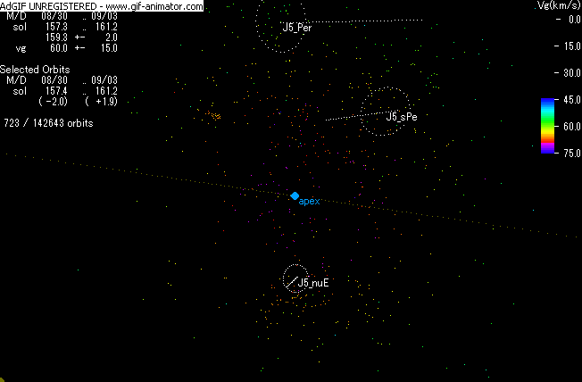
Results (X)
Orbits between 160 and 200° sol long from 6 years of SonotaCo
network data.
Each image represents 4° in sol long with 1° shift.

Slide 22
Results (XI)
28 SOA is an early, 286 FTA a late part of 2 STA.
Notes:
Southern Taurids
Southern October delta Arietids
omega Taurids

Slide 23
Results (XII)
20 DLM were deleted from the MDC list, because they were believed to be identical to COM.
Notes:
December Leonis Minorids
Comae Berenicids

Slide 24
Results (XIII)
11 EVI and 49 LVI are two identical showers.
Notes:
eta Virginids
lambda Virginids

Slide 25
Results (XIV)
55 ASC and 150 SOP are two identical showers.
Notes:
alpha Scorpiids
Southern May Ophiuchids

Slide 26
Results (XV)
Do 516 FMV intersect with the N Apex source?
Notes:
February mu Virginids

Slide 27
Conclusions
The MDC list has certain weaknesses which may results in double registration of meteor showers:
Only the peak sol long is given, but not the activity interval.
Certain long-lasting meteor showers cannot be well described with a single set of parameters (e.g. variable or radiant drift).
It should be decided whether complex sources like Antihelion are treated as one, or as a set of individual meteor showers.
In the latter case we find half a dozen new showers.
Dormant showers should be clearly marked as such.
An (online) tool may help to identify meteor showers and prevent double registration of showers.

Slide 28
Thanks for your Attention
Questions?

